Slide 1
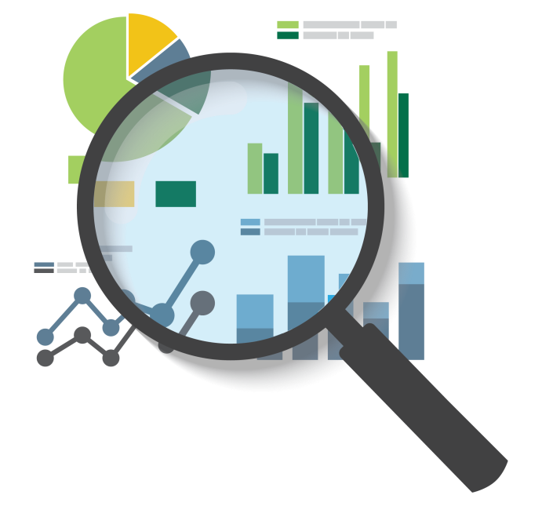
DATA ANALYTICS
PROCESS
Application in real life scenario case study
Shivam Singh

Slide 2
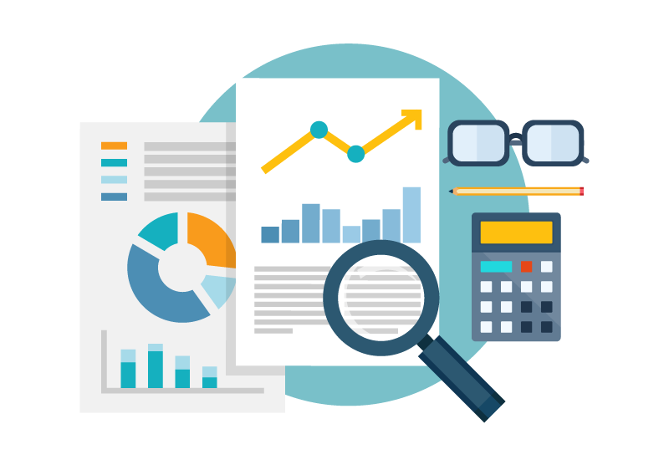
Introduction
Data analytics transforms raw data into actionable insights for informed decision-making and strategic planning.
Steps of Data analytics
Plan Prepare
Process Analyze
Share Act
Real-life scenario: Opening a small grocery store.

Slide 3

Plan
Where are the target markets?
What are the best locations for the store?
What products are in high demand?
Who is the best supplier?
Connect local community.

Slide 4

Prepare
Estimate how much money you are willing to spend.
How to get that money?
Prepare your shop
Gather local data , consumer preferences,
competitor analysis.

Slide 5

Process
Complete process to ready shop.
Get your products for shop.
Make your payment method ready.
Set your price list.
Make your shop open
after ready.

Slide 6

Analyze
Compare your prize and set accordingly.
Analyze your customer preference.
Analyze the demand for your product and organize your store based on that.
Analyze factor affecting demand.
Make pattern/ strategies.

Slide 7

Share
Share your finding with helper.
Share your insights on community.
Share with stakeholder / invester.

Slide 8

Act
Implement all decision.
Monitor results: track sales, feedback.
Adjust your product make
seasonal change.
Act according customer
preference.

Slide 9
Thank you

